Slide 1
Graph Theory

Slide 2
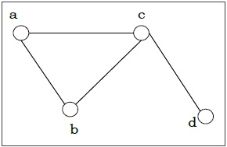
Definition
A graph (denoted as G=(V,E) consists of a non-empty set of vertices or nodes V and a set of edges E.
Example − Let us consider, a Graph is G=(V,E) whereV={a,b,c,d} and E={{a,b},{a,c},{b,c},{c,d}}

Slide 3
Degree of a Vertex − The degree of a vertex V of a graph G (denoted by deg (V)) is the number of edges incident with the vertex V.
Even and Odd Vertex − If the degree of a vertex is even, the vertex is called an even vertex and if the degree of a vertex is odd, the vertex is called an odd vertex.
Degree of a Graph − The degree of a graph is the largest vertex degree of that graph. For the below graph the degree of the graph is 3.
The Handshaking Lemma − In a graph, the sum of all the degrees of all the vertices is equal to twice the number of edges.
Vertex | Degree | Even / Odd
a | 2 | even
b | 2 | even
c | 3 | odd
d | 1 | odd

Slide 4
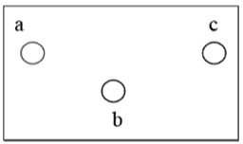
Types of Graphs
There are different types of graphs, which we will learn in the following section.
Null Graph
A null graph has no edges. The null graph of nvertices is denoted by N_{n}

Slide 5
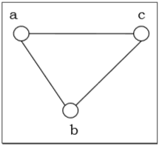
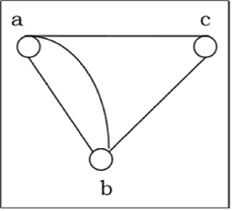
Simple Graph
A graph is called simple graph/strict graph if the graph is undirected and does not contain any loops or multiple edges.
Multi-Graph
If in a graph multiple edges between the same set of vertices are allowed, it is called Multigraph. In other words, it is a graph having at least one loop or multiple edges.

Slide 6
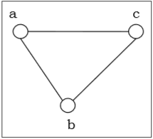
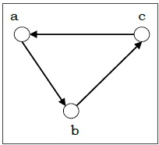
Directed and Undirected Graph
A graph G=(V,E)is called a directed graph if the edge set is made of ordered vertex pair and a graph is called undirected if the edge set is made of unordered vertex pair.
Undirected Graph
Directed Graph

Slide 7
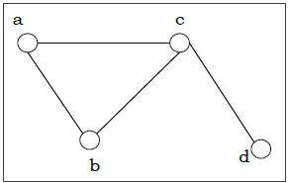
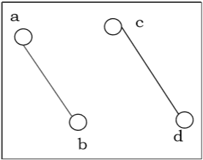
Connected and Disconnected Graph
A graph is connected if any two vertices of the graph are connected by a path; while a graph is disconnected if at least two vertices of the graph are not connected by a path. If a graph G is disconnected, then every maximal connected subgraph of G is called a connected component of the graph G.
Connected Graph
Disconnected Graph

Slide 8
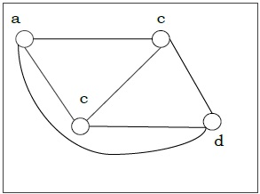
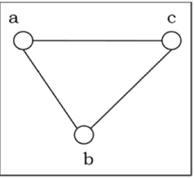
Regular Graph
A graph is regular if all the vertices of the graph have the same degree. In a regular graph G of degree r, the degree of each vertex of G is r.
Complete Graph
A graph is called complete graph if every two vertices pair are joined by exactly one edge. The complete graph with n vertices is denoted by Kn

Slide 9
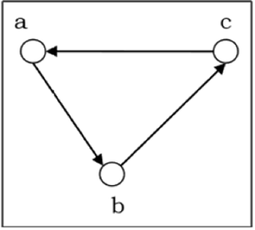
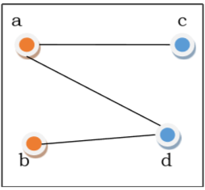
Cycle Graph
If a graph consists of a single cycle, it is called cycle graph. The cycle graph with n vertices is denoted by C_{n}
Bipartite Graph
If the vertex-set of a graph G can be split into two disjoint sets, V1 and V2, in such a way that each edge in the graph joins a vertex in V1 to a vertex in V2, and there are no edges in G that connect two vertices in V1 or two vertices in V2, then the graph G is called a bipartite graph.

Slide 10
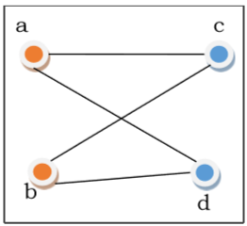
Complete Bipartite Graph
A complete bipartite graph is a bipartite graph in which each vertex in the first set is joined to every single vertex in the second set. The complete bipartite graph is denoted by Kx,y where the graph G contains x vertices in the first set and y vertices in the second set.

Slide 11
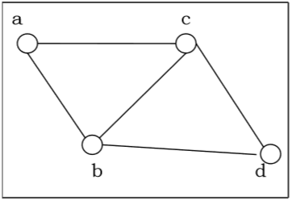
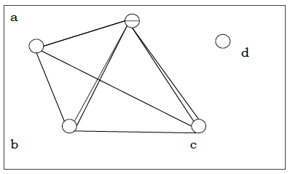
Planar graph
A graph GG is called a planar graph if it can be drawn in a plane without any edges crossed. If we draw graph in the plane without edge crossing, it is called embedding the graph in the plane.
Non-planar graph
A graph is non-planar if it cannot be drawn in a plane without graph edges crossing.

Slide 12
Representation of Graphs
There are mainly two ways to represent a graph −
Adjacency Matrix
Adjacency List
Adjacency Matrix
An Adjacency Matrix A[V] is a 2D array of size V×V where V is the number of vertices in a undirected graph. If there is an edge between V_{x} to V_{y} then the value of A[V_{x}][V_{y}]=1 and A[V_{y}][V_{x}]=1, otherwise the value will be zero. And for a directed graph, if there is an edge between V_{x} to V_{y}, then the value of A[V_{x}][V_{y}]=1, otherwise the value will be zero.

Slide 13
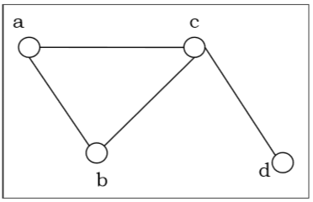
Adjacency Matrix of an Undirected Graph
Let us consider the following undirected graph and construct the adjacency matrix −
Adjacency matrix of the above undirected graph will be −
 | a | b | c | d
a | 0 | 1 | 1 | 0
b | 1 | 0 | 1 | 0
c | 1 | 1 | 0 | 1
d | 0 | 0 | 1 | 0

Slide 14
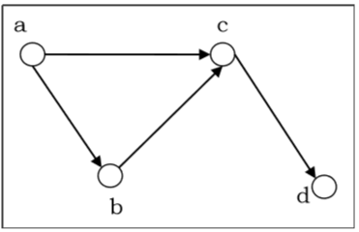
Adjacency Matrix of a Directed Graph
Let us consider the following directed graph and construct its adjacency matrix
Adjacency matrix of the above directed graph will be −
 | a | b | c | d
a | 0 | 1 | 1 | 0
b | 0 | 0 | 1 | 0
c | 0 | 0 | 0 | 1
d | 0 | 0 | 0 | 0

Slide 15
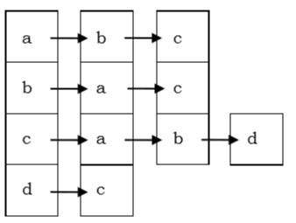
Adjacency List
In adjacency list, an array (A[V]) of linked lists is used to represent the graph G with V number of vertices. An entry A[V_{x}] represents the linked list of vertices adjacent to the V_{x}−th vertex. The adjacency list of the undirected graph is as shown in the figure below −

Slide 16
Questions
Consider a graph G with vertices {v₁, v₂, v₃, v₄} and edges (v₁, v₃),(v₁, v₄),(v₂, v₃). Which of the following are subgraphs of G?
Graph G₁ with vertex v₁ and edge (v₁, v₃)
Graph G₂ with vertices {v₁, v₃} and no edges
Graph G₃ with vertices {v₁, v₂} and edge (v₁, v₂)
2. Consider a graph G with 5 nodes and 7 edges. Can G be bipartite?

